Slide 1

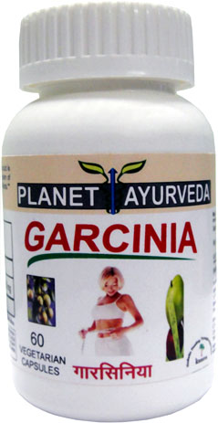
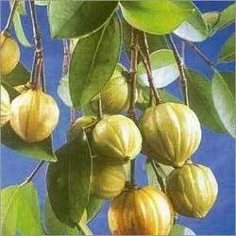


Healing Properties of Garcinia Cambogia
Weight Loss Treatment.
Natural Appetite Suppressant.
Reduce Cholesterol Level Naturally.
Helps to Increase Body Energy.
Enhance our Body's Immune System.
Reduce Stomach Acidity.
Garcinia Herb

Slide 2




PLANET AYURVEDA
GARCINIA CAPSULES
(www.Planetayurveda.com)
What is Garcinia Cambogia (Vrikshamla)
Garcinia cambogia (Vrikshamla) is most commonly known as ‘Garcinia’.
It is also known as ‘Malabar tamarind’ and it belongs to the citrus family.
It is a small and sweet, pumpkin-like fruit native to South Asia and India.
It is known for its high concentration of Hydroxycitric Acid (HCA) for effective weight loss treatment.

Slide 3
PLANET AYURVEDA
GARCINIA CAPSULES
(www.Planetayurveda.com)
Botanical Classification
Kingdom | Plantae
Division | Angiospermae
Class | Magnoliopsida
Order | Malpighiales
Family | Clusiaceae
Genus | Garcinia
Species | Cambogia
Part used | Fruit

Slide 4
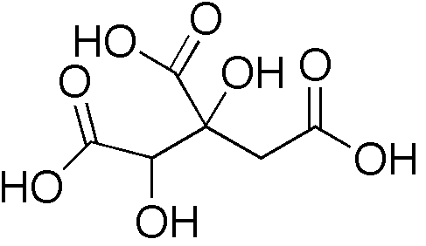
PLANET AYURVEDA
GARCINIA CAPSULES
(www.Planetayurveda.com)
Garcinia Cambogia - Scientific Information
Hydroxycitric acid (HCA) is a compound found in the fruit of Garcinia cambogia. Its chemical structure is similar to that of citric acid.
Animal studies on Hydroxycitric acid (HCA) suggest that it inhibits fat synthesis and suppresses appetite.
More studies done on HCA revealed that conversion of carbohydrates into stored fat get reduced due to inhibition of certain enzyme processes.

Slide 5
PLANET AYURVEDA
GARCINIA CAPSULES
(www.Planetayurveda.com)
Benefits of Garcinia Cambogia
Garcinia cambogia is the most effective herbal supplement for the treatment of weight loss.
It prevents the storage of carbohydrates as fats and controls obesity in a natural way.
Its main constituent Hydrochloric acid (HCA) suppresses appetite and causes the body to burn fat effectively.
It helps to lower cholesterol levels.
It contains large amount of ascorbic acid and acts as a Heart tonic.
Improve the functioning of kidney and urinary system.
It protects the stomach and prevents the symptoms of acidity.
It also helps to boost energy levels naturally.
It also helps in combating various body infections.
It is also effective in various skin problems.
It also possess anti inflammatory and anti ulcerogenic properties.
It removes toxins from the body and improves overall health.

Slide 6

PLANET AYURVEDA
GARCINIA CAPSULES
(www.Planetayurveda.com)
Garcinia for Weight Loss Treatment
Garcinia is the best herbal supplement for weight loss treatment.
Garcinia is very effective in weight management and fat reduction.
Garcinia helps the body burn fat and depress the appetite in a natural way.
Garcinia works in an effective way and supports weight loss by blocking the storage of carbohydrates as fats.

Slide 7

PLANET AYURVEDA
GARCINIA CAPSULES
(www.Planetayurveda.com)
Natural Appetite Suppressant
Garcinia cambogia has been used for centuries in Ayurveda as a natural appetite suppressant.
It is the best herbal supplement which helps to aid natural appetite suppression.
It leads to decrease in appetite and boosts the metabolism.
It encourages the production of serotonin and stimulates synthesis of glycogen, which signals a sense of fullness to the brain.

Slide 8

PLANET AYURVEDA
GARCINIA CAPSULES
(www.Planetayurveda.com)
Garcinia Controls Cholesterol Level Naturally
Garcinia cambogia helps to lower cholesterol levels.
Its main constituent Hydrochloric acid (HCA) helps to reduce total cholesterol, LDL cholesterol and triglyceride levels in individuals.
It helps to promote weight loss and lower plasma cholesterol.

Slide 9

PLANET AYURVEDA
GARCINIA CAPSULES
(www.Planetayurveda.com)
Garcinia Helps to Increase Body Energy
Garcinia cambogia is a natural weight loss supplement and helps to boost energy levels.
It reduces the body's ability to make and store new fat so that previously stored fat is burned off.
It fills the glycogen stores in the liver, thereby reducing appetite while increasing energy levels.

Slide 10

PLANET AYURVEDA
GARCINIA CAPSULES
(www.Planetayurveda.com)
Garcinia Cambogia – Effective Weight Loss Pills
Hydroxycitric acid (HCA) is the main effective constituent present in Garcinia cambogia.
It prevents fat synthesis and fat accumulation.
It increases burning of fats and also inhibits the craving for carbohydrates.
It helps in the treatment of weight loss and keeps the weight under control.

Slide 11

PLANET AYURVEDA
GARCINIA CAPSULES
(www.Planetayurveda.com)
Side Effects of Garcinia Cambogia
No side effects have been reported so far as Garcinia capsules are prepared from the pure extract obtained from Garcinia herb.

Slide 12
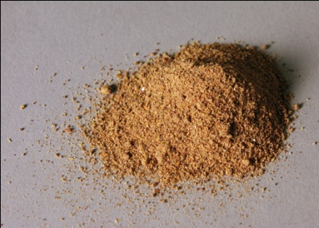
PLANET AYURVEDA
GARCINIA CAPSULES
(www.Planetayurveda.com)
Ingredients
500mg Garcinia Extract.

Slide 13

PLANET AYURVEDA
GARCINIA CAPSULES
(www.Planetayurveda.com)
Dosage of Garcinia Capsules
1-2 Capsules twice daily, with plain water after meals.

Slide 14
Buy Garcinia Capsules
Packs | Retail Price | Sale Price | Order Now
2 Bottles | $49.90 | $42.95 | Buy Now
3 Bottles | $74.85 | $67.95 | Buy Now
5 Bottles | $124.75 | $109.95 | Buy Now
10 Bottles | $249.95 | $119.95 | Buy Now
Each Bottle Contains 60 Vegetarian Capsules
Our Garcinia product is purely natural, comes in vegetarian capsules and does not contain any chemicals or synthetic agents.
For More Detail Visit us at:
Website : www.Planetayurveda.com
E-mail id : herbalremedies123@yahoo.com

Slide 15
About Planet Ayurveda Company
US-FDA registered herbal company.
Exporting natural products and supplements to US, Europe, Singapore, Malaysia, Australia, Japan, Africa.
A GMP certified manufacturing unit located near Shivalik range of Himalayan mountains.
Headed by MD (Ayurveda- herbal pharmacology expert doctor).
Website – www.planetayurveda.com
Contact Us
#3604, Sector 23-D,
Chandigarh-160023 -INDIA
Phone - 0091-172-3054840, 5073604 (Work)
Fax - 0091-172-3054840 (Work)
Cell Phone - Manager - 0091-9915593604
E Mail ID - Customer Care - herbalremedies123@yahoo.com
Website - www.planetAyurveda.com & www.Krishnaherbals.com

